Slide 1
LX Adversarial Attacks
Z. Gu 2021

Slide 2
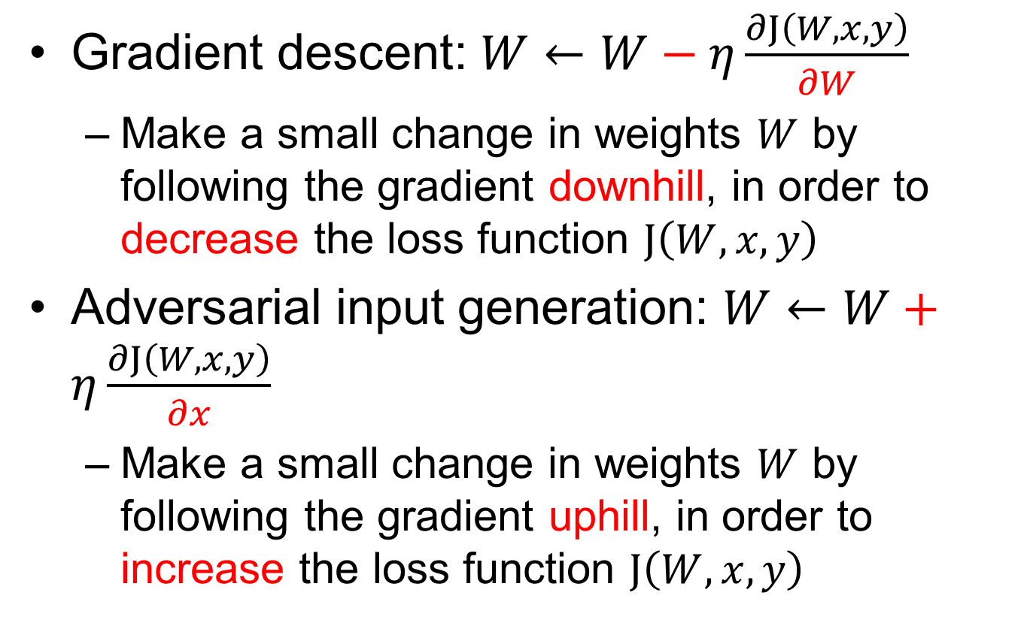
Gradient descent vs. Adversarial input generation
Gradient descent: $W←W−η\frac{∂J\left(W,x,y\right)}{∂W}$
Make a small change in weights $W$ by following the gradient downhill, in order to decrease the loss function $J\left(W,x,y\right)$
Adversarial input generation: $W←W+η\frac{∂J\left(W,x,y\right)}{∂x}$
Make a small change in weights $W$ by following the gradient uphill, in order to increase the loss function $J\left(W,x,y\right)$

Slide 3
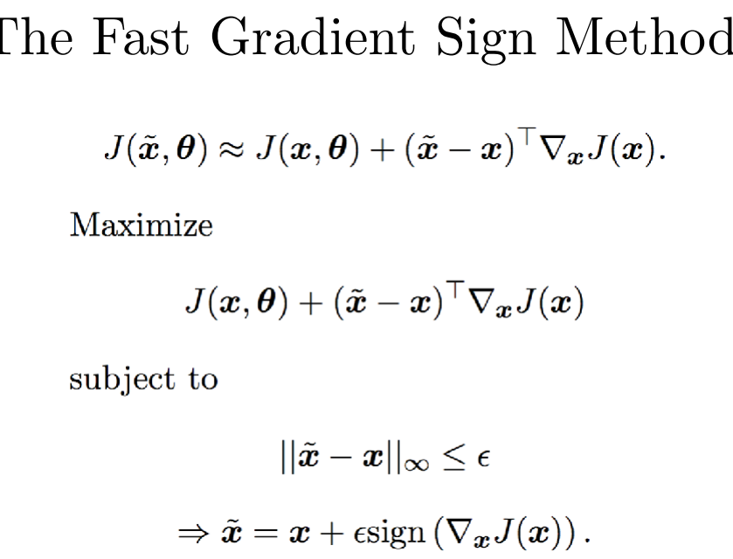
FGSM

